Slide 1
Ideal Living x Amazon
2025 Full Year Performance Overview
Amazon Advertising | Ad-Driven vs Organic Analysis
Full Year 2025 (Weeks 1–53)
AMAZON SPONSORED ADS

Slide 2
2025 FULL YEAR PERFORMANCE
Overall Performance Summary
Metric | Value | Detail
Total Revenue | $3,193,483 | Across 10 brands, 55 weeks
Total Units Sold | 52,865 | 47,782 orders
Ad-Driven Revenue | $991,694 | 31.1% of total revenue
Organic Revenue | $2,201,141 | 68.9% of total revenue
Total Ad Spend | $426,781 | TACoS: 13.4%
ROAS | 2.32x | $2.32 ad revenue per $1 spend
ACoS | 43.0% | Ad spend as % of ad revenue
Sessions | 240,967 | Avg 4,381/week
Conversion Rate | 19.8% | Orders / Sessions
Impressions | 44,708,551 | Avg 812,883/week
Takeaways:
• Full year: $3,193,483 revenue from 52,865 units across 55 weeks
• Organic revenue ($2,201,141, 68.9%) far exceeds ad-driven ($991,694, 31.1%)
• ROAS of 2.32x with 13.4% TACoS — ads augment strong organic demand
• Avg weekly revenue: $58,063, avg weekly spend: $7,760

Slide 3
2025 FULL YEAR PERFORMANCE
Ad-Driven vs Organic Revenue — Total
Metric | Ad-Driven | Organic | Total | % Ad-Driven
Units | 14,785 | 38,080 | 52,865 | 28.0%
Revenue ($) | $991,694 | $2,201,141 | $3,193,483 | 31.1%
Ad Spend ($) | $426,781 | — | $426,781 | 100%
ROAS | 2.32x | — | 2.32x | —
ACoS | 43.0% | — | 43.0% | —
Takeaways:
• TACoS of 13.4% — ad spend is a small, efficient portion of total revenue
• Organic revenue (68.9%) demonstrates strong brand equity and repeat purchasing
• Every $1 of ad spend generates $2.32 in attributed ad revenue
• The ~69/31 organic-to-ad split shows ads complement rather than sustain revenue

Slide 4
2025 FULL YEAR PERFORMANCE
Performance by Brand
Brand | Revenue | Units | Ad Spend | Ad Sales | Organic | ROAS | ACoS | TACoS
Prosvent | $1,777,284 | 29,956 | $244,591 | $565,908 | $1,211,376 | 2.31x | 43.2% | 13.8%
Better Bladder | $658,094 | 9,956 | $80,854 | $200,815 | $457,279 | 2.48x | 40.3% | 12.3%
Ideal Prostate | $600,771 | 9,369 | $80,198 | $192,396 | $408,375 | 2.40x | 41.7% | 13.3%
Cebria | $53,253 | 1,451 | $6,868 | $8,526 | $44,727 | 1.24x | 80.6% | 12.9%
Grown American | $44,158 | 1,052 | $4,222 | $12,983 | $31,105 | 3.08x | 32.5% | 9.6%
Profemin | $28,904 | 528 | $3,609 | $3,187 | $25,717 | 0.88x | 113.2% | 12.5%
BeFlexible | $17,597 | 252 | $687 | $690 | $16,418 | 1.00x | 99.7% | 3.9%
AromaTru | $12,614 | 274 | $5,709 | $7,129 | $5,396 | 1.25x | 80.1% | 45.3%
Perfect Omega | $809 | 27 | $43.89 | $59.90 | $749 | 1.36x | 73.3% | 5.4%
Takeaways:
• Prosvent dominates at $1,777,284 (55.7% of total)
• Top 3 brands represent 95.1% of total revenue
• Grown American has highest ROAS at 3.08x — most efficient ad spend
• BeFlexible and Perfect Omega run with minimal ad budgets and strong organic bases

Slide 5
2025 FULL YEAR PERFORMANCE
Ad-Driven vs Organic Revenue by Brand
Brand | Total Revenue | Ad Revenue | Organic | % Ad | % Organic | Profile
Prosvent | $1,777,284 | $565,908 | $1,211,376 | 31.8% | 68.2% | Balanced
Better Bladder | $658,094 | $200,815 | $457,279 | 30.5% | 69.5% | Balanced
Ideal Prostate | $600,771 | $192,396 | $408,375 | 32.0% | 68.0% | Balanced
Cebria | $53,253 | $8,526 | $44,727 | 16.0% | 84.0% | Organic-Led
Grown American | $44,158 | $12,983 | $31,105 | 29.4% | 70.4% | Balanced
Profemin | $28,904 | $3,187 | $25,717 | 11.0% | 89.0% | Organic-Led
BeFlexible | $17,597 | $690 | $16,418 | 3.9% | 93.3% | Organic-Led
AromaTru | $12,614 | $7,129 | $5,396 | 56.5% | 42.8% | Ad-Heavy
Perfect Omega | $809 | $59.90 | $749 | 7.4% | 92.6% | Organic-Led
Takeaways:
• Most brands are Organic-Led (65-93% organic) — strong underlying demand
• AromaTru is the only Ad-Heavy brand (56.5% ad revenue) — newer product building awareness
• Core brands (Prosvent, Better Bladder, Ideal Prostate) maintain ~30% ad / ~70% organic balance
• Opportunity: modest ad support for high-organic brands could accelerate growth

Slide 6
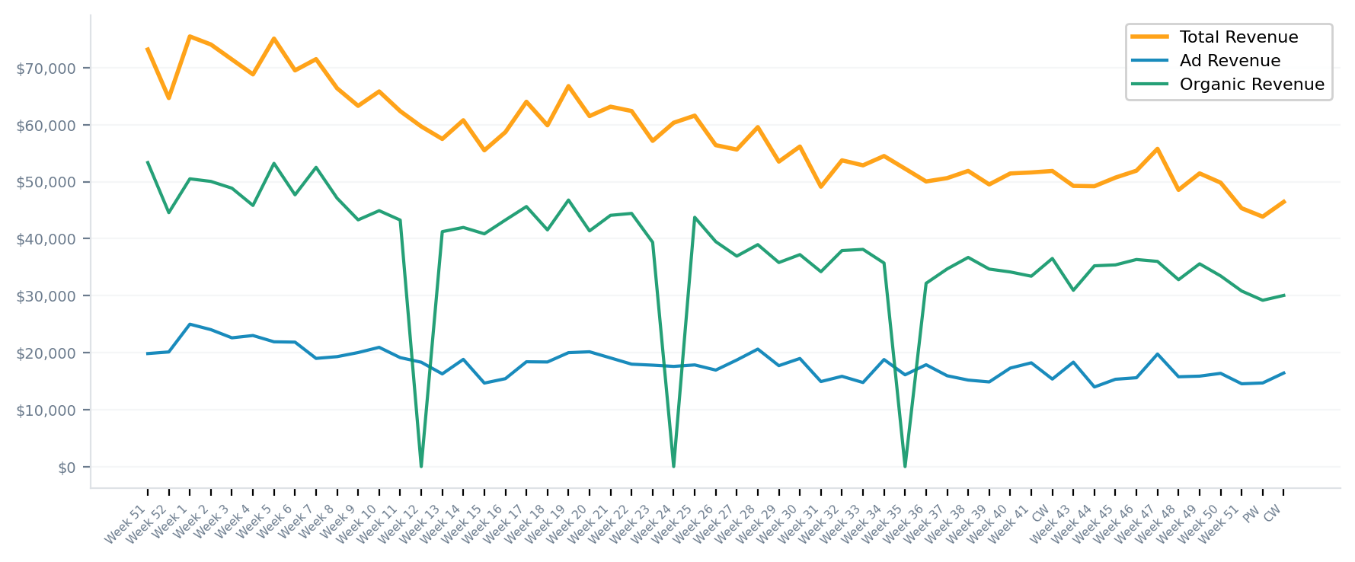
2025 FULL YEAR PERFORMANCE
Weekly Trends — Revenue
Takeaways:
• Peak revenue: 2025 - Week 1 at $75,479
• Low revenue: Previous Week at $43,849
• Q1 avg $69,356/wk vs Q4 avg $49,674/wk — gradual decline through the year
• Organic revenue consistently 60-70% of total, providing a stable revenue floor

Slide 7
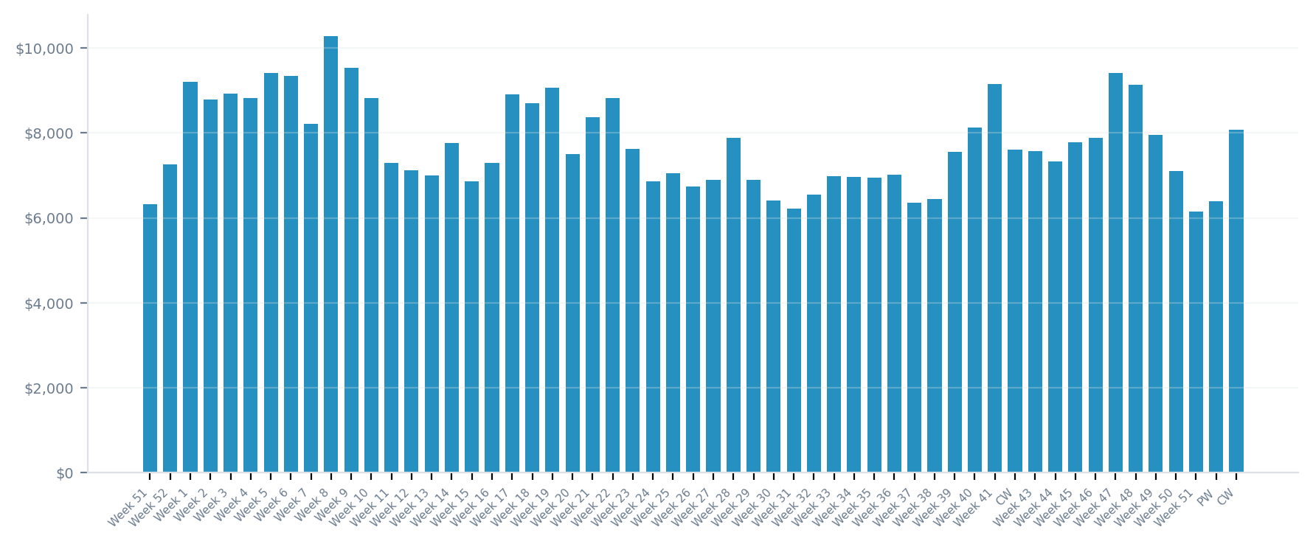
2025 FULL YEAR PERFORMANCE
Weekly Trends — Ad Spend
Takeaways:
• Total ad spend: $426,781 across 55 weeks
• Average weekly spend: $7,760 (range: $6,156 – $10,279)
• Peak spend: 2025 - Week 8 at $10,279
• Spend consistent at $6K-$10K/wk with slight Q4 holiday uptick

Slide 8
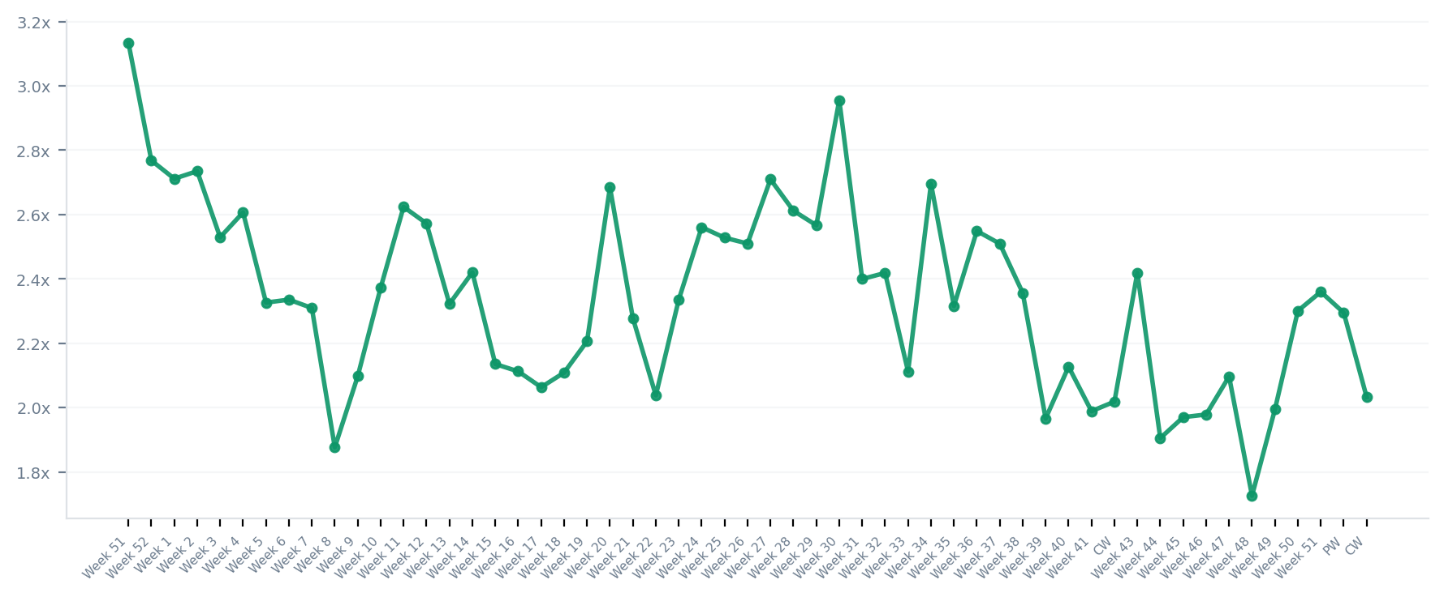
2025 FULL YEAR PERFORMANCE
Weekly Trends — ROAS
Takeaways:
• Average weekly ROAS: 2.34x
• ROAS range: 1.73x – 3.13x
• Q1 ROAS averaged ~2.5x vs Q4 ~2.0x — declining efficiency as traffic softened
• ROAS remained profitable (>1.7x) throughout the entire year

Slide 9
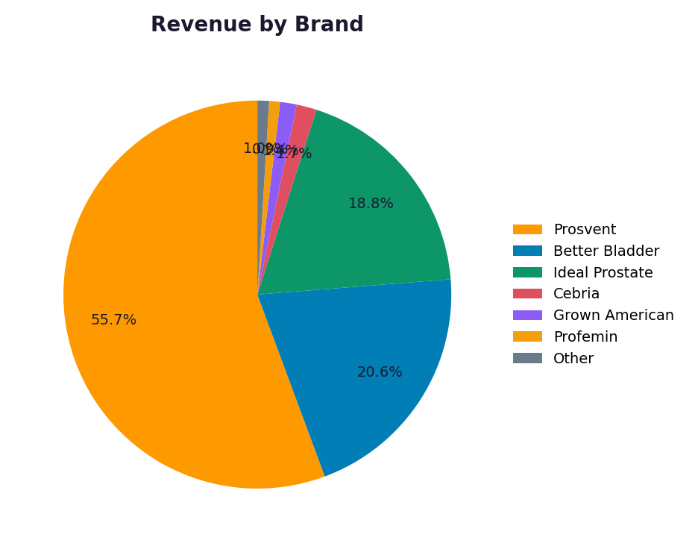
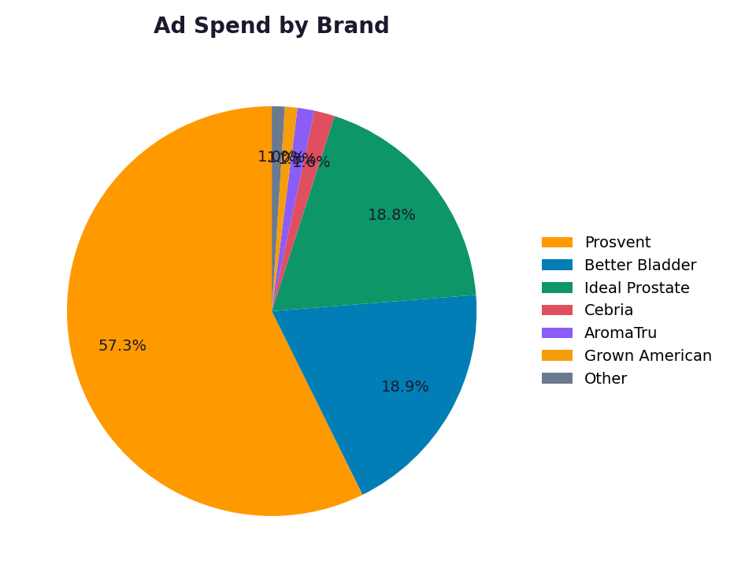
2025 FULL YEAR PERFORMANCE
Revenue & Ad Spend Distribution by Brand
Takeaways:
• Prosvent dominates revenue (55.7%) and ad spend (57.3%)
• Top 3 brands account for 95.1% of revenue
• Revenue and spend distributions are well-aligned — no brand over-spending vs revenue share
• Long tail brands (Cebria, BeFlexible, Perfect Omega) contribute <2% each

Slide 10
2025 FULL YEAR PERFORMANCE
Brand Efficiency — ROAS, ACoS & TACoS
Brand | Ad Spend | Ad Sales | ROAS | ACoS | TACoS | Impressions | Rating
Prosvent | $244,591 | $565,908 | 2.31x | 43.2% | 13.8% | 21,013,243 | ★★
Better Bladder | $80,854 | $200,815 | 2.48x | 40.3% | 12.3% | 7,652,320 | ★★
Ideal Prostate | $80,198 | $192,396 | 2.40x | 41.7% | 13.3% | 11,245,716 | ★★
Cebria | $6,868 | $8,526 | 1.24x | 80.6% | 12.9% | 2,067,657 | ★
Grown American | $4,222 | $12,983 | 3.08x | 32.5% | 9.6% | 433,223 | ★★★
Profemin | $3,609 | $3,187 | 0.88x | 113.2% | 12.5% | 619,074 | ▼
BeFlexible | $687 | $690 | 1.00x | 99.7% | 3.9% | 91,974 | ★
AromaTru | $5,709 | $7,129 | 1.25x | 80.1% | 45.3% | 1,548,768 | ★
Perfect Omega | $43.89 | $59.90 | 1.36x | 73.3% | 5.4% | 36,576 | ★
Takeaways:
• Highest ROAS: Grown American at 3.08x
• Lowest ROAS (meaningful spend): Profemin at 0.88x
• Prosvent spends $244,591 but maintains 2.31x ROAS at scale
• TACoS across portfolio is 3-45% — most brands well under 15%

Slide 11
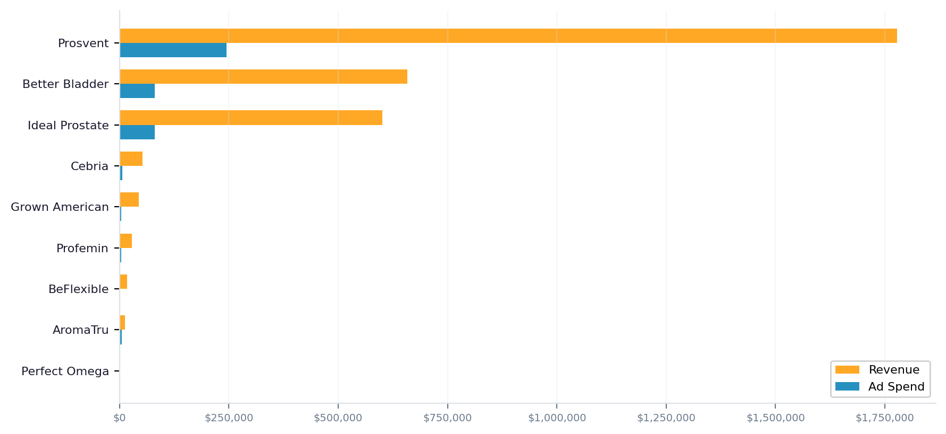
2025 FULL YEAR PERFORMANCE
Revenue vs Ad Spend by Brand
Takeaways:
• Revenue-to-spend leverage is massive across all brands
• Prosvent: $1,777,284 revenue on $244,591 spend
• All brands generate positive revenue relative to their ad investment

Slide 12
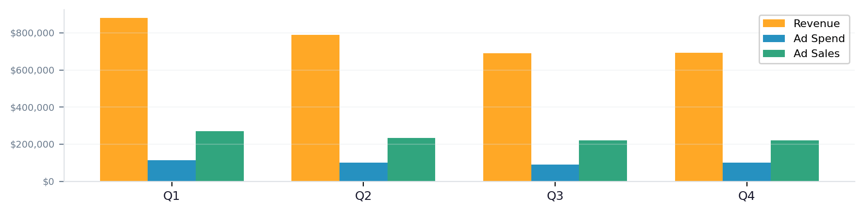
2025 FULL YEAR PERFORMANCE
Quarterly Performance Comparison
Quarter | Revenue | Units | Ad Spend | Ad Sales | Organic | ROAS | ACoS | TACoS
Q1 | $880,958 | 14,650 | $112,778 | $271,224 | $568,361 | 2.40x | 41.6% | 12.8%
Q2 | $788,119 | 13,093 | $101,588 | $232,931 | $512,430 | 2.29x | 43.6% | 12.9%
Q3 | $689,369 | 11,345 | $89,130 | $220,206 | $432,995 | 2.47x | 40.5% | 12.9%
Q4 | $692,870 | 11,431 | $101,210 | $220,896 | $471,974 | 2.18x | 45.8% | 14.6%
Takeaways:
• Q1 strongest at $880,958 with 2.40x ROAS
• Revenue declined 21.4% Q1→Q4 — seasonal demand pattern
• ROAS: Q1 2.40x → Q4 2.18x
• Sessions dropped ~40% Q1→Q4 — primary driver of revenue decline

Slide 13
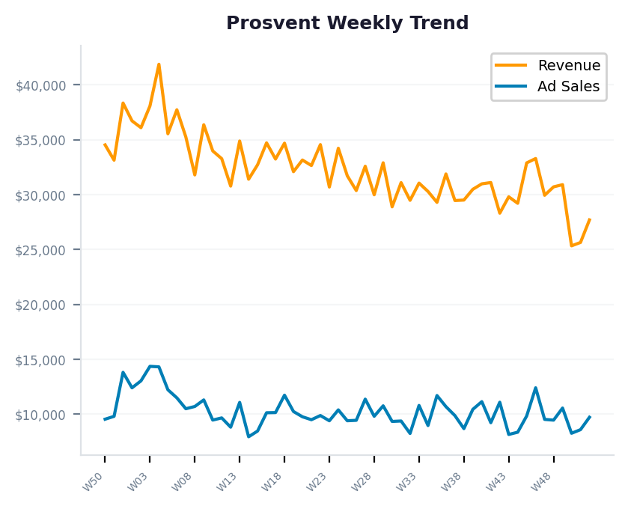
2025 BRAND DEEP DIVE
Prosvent — Full Year Performance
Metric | Value | Detail
Total Revenue | $1,777,284 | 55.7% of portfolio
Units Sold | 29,956 | 27,206 orders
Avg Selling Price | $59.33
Ad Spend | $244,591 | TACoS: 13.8%
Ad Revenue | $565,908 | 31.8% of revenue
Organic Revenue | $1,211,376 | 68.2% of revenue
ROAS / ACoS | 2.31x / 43.2%
Sessions / Conv | 108,087 / 25.2%
Impressions | 21,013,243 | 55 active weeks
Takeaways:
• Portfolio anchor — largest revenue and ad spend contributor
• Strong organic base (68%) signals established loyalty and repeat buyers
• ROAS of 2.31x at $245K spend proves scalability — room to push further
• Recommend: test incremental 10-15% budget increases while monitoring ACoS

Slide 14
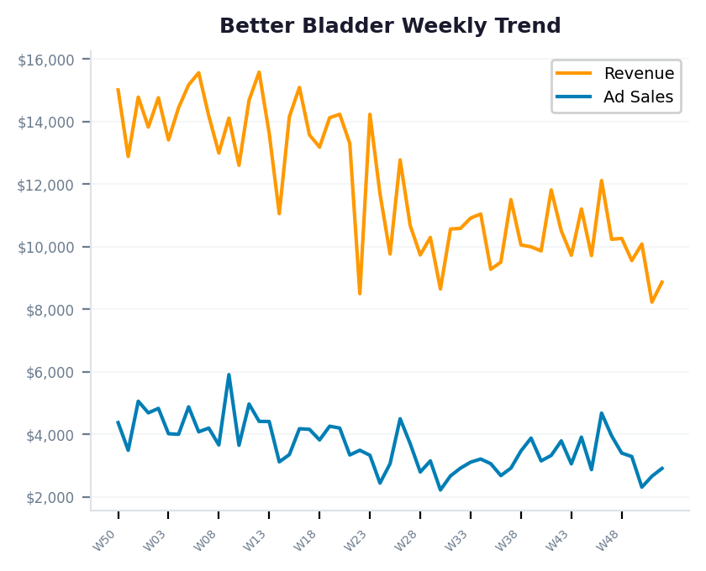
2025 BRAND DEEP DIVE
Better Bladder — Full Year Performance
Metric | Value | Detail
Total Revenue | $658,094 | 20.6% of portfolio
Units Sold | 9,956 | 9,272 orders
Avg Selling Price | $66.10
Ad Spend | $80,854 | TACoS: 12.3%
Ad Revenue | $200,815 | 30.5% of revenue
Organic Revenue | $457,279 | 69.5% of revenue
ROAS / ACoS | 2.48x / 40.3%
Sessions / Conv | 65,052 / 14.3%
Impressions | 7,652,320 | 55 active weeks
Takeaways:
• #2 revenue brand with best ROAS of 2.48x among top spenders
• 70% organic revenue shows strong product-market fit
• Efficient ad engine — $81K spend generating $201K ad revenue
• Recommend: increase budget to capture more non-brand category traffic

Slide 15
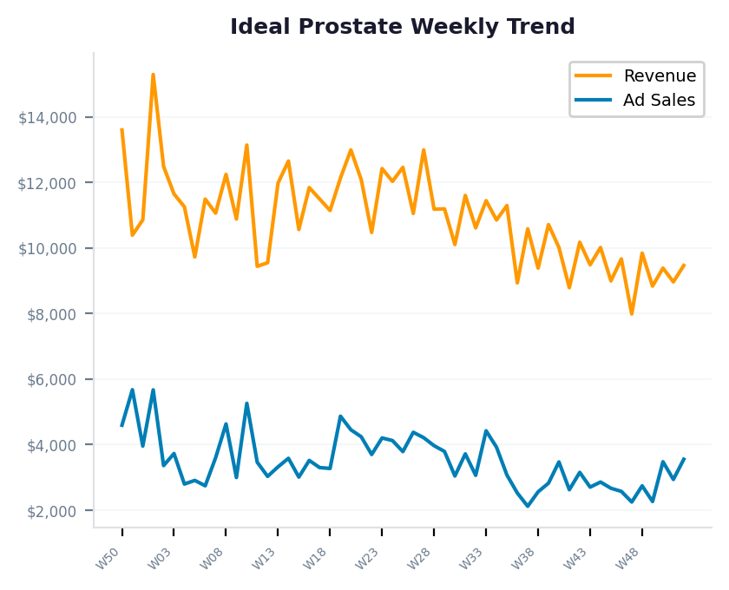
2025 BRAND DEEP DIVE
Ideal Prostate — Full Year Performance
Metric | Value | Detail
Total Revenue | $600,771 | 18.8% of portfolio
Units Sold | 9,369 | 8,405 orders
Avg Selling Price | $64.12
Ad Spend | $80,198 | TACoS: 13.3%
Ad Revenue | $192,396 | 32.0% of revenue
Organic Revenue | $408,375 | 68.0% of revenue
ROAS / ACoS | 2.40x / 41.7%
Sessions / Conv | 40,903 / 20.5%
Impressions | 11,245,716 | 55 active weeks
Takeaways:
• #3 revenue brand, closely trailing Better Bladder
• ROAS of 2.40x at $80K spend — efficient and scalable
• Category overlap with Prosvent creates cross-sell opportunities
• Recommend: leverage Prosvent audience data for targeted campaigns

Slide 16
2025 FULL YEAR PERFORMANCE
2026 Strategic Recommendations
▸ Scale Prosvent & High-ROAS Brands
Prosvent ($1,777,284 at 2.3x ROAS) and Grown American (3.1x) have proven efficiency. Increase budgets 10-20% in Q1 2026 while monitoring ACoS.
▸ Address Year-over-Year Revenue Decline
Revenue declined 21.4% Q1→Q4. Analyze seasonal vs competitive factors. Counter with seasonal promotions, Lightning Deals, and increased spend during slow periods.
▸ Optimize Low-ROAS Campaigns
Profemin (0.88x ROAS) needs campaign-level review. Audit search terms, refine keyword targeting, pause non-converting campaigns.
▸ Strengthen Organic Revenue Base
Organic revenue (68.9%) is a competitive advantage. Invest in A+ Content, listing optimization, review generation, and Subscribe & Save.
▸ Build Brand vs Non-Brand Search Strategy
Once search term data is available, separate Brand (defensive) vs Non-Brand (conquest) campaigns. This enables differentiated bidding, budget allocation, and ROAS targets.
▸ Explore New Brand Growth
AromaTru and Perfect Omega are in early growth stages. Set aggressive ACoS targets, invest in awareness campaigns, and track trajectory toward organic demand.

